Slide 1
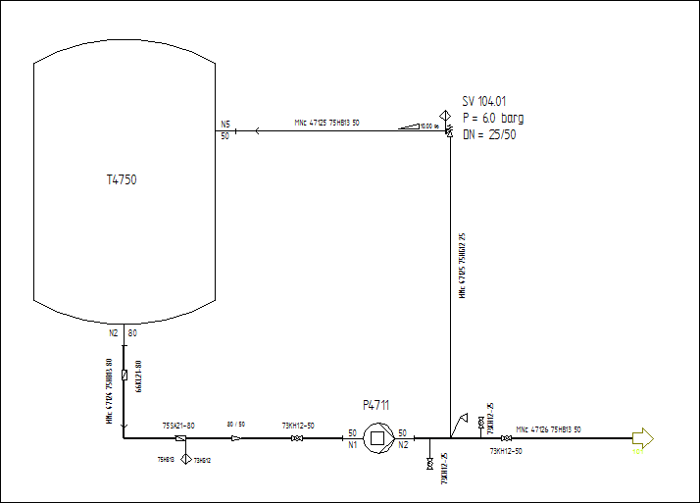
DEXPI Example Tank Displ Pump Pipe with Tee
This is the DEXPI Example Tank T4750 Displacement Pump P4711 Pipe with Tee and Refief Valve

